Slide 1



INTERNATIONAL NETWORK OF FINANCIAL CENTRES FOR SUSTAINABILITY (FC4S NETWORK)
Clusters & Connectivity for Sustainable Finance
Stephen Nolan, FC4S Managing Director
April 9th 2019

Slide 2

OVERVIEW
A global shift is underway – an increasing number of leading financial centres are taking strategic action on sustainable finance
UN Environment established the FC4S Network in September 2017, now with 20+ members worldwide
In 2019, the FC4S Network is driving collaborative projects, engaging new members, advising on strategies
The FC4S State of Play report – ‘Shifting Gears’ – summarizes the results of a global self-assessment of financial centre action
In Europe, FC4S facilitates policy engagement with the European Commission, and strategic projects between European centres
The FC4S Network aims to materially accelerate growth in sustainable finance markets in 2019 – with special focus on Africa

Slide 3
CONTEXT
The Strategic Role of Financial Centres for Green and Sustainable Development

Slide 4
SUSTAINABLE FINANCE: A GLOBAL SHIFT
$70 trillion
Total assets under management of companies which are signatories to the Principles for Responsible Investment
$140 billion
Total insured losses from natural disasters in 2017 (hurricanes, wildfires)
14x
Increase in annual issuance of labelled green bonds from 2013 to 2017, from $11 to $155 billion
270
Total number of of sub-national, national, and regional-level policy actions on sustainable finance end-2017, double the number in 2013.

Slide 5
WHY FOCUS ON FINANCIAL CENTRES?
100+ major financial centres around the world – a key community to accelerate finance for sustainable development and climate action
Harnessing the Cluster Effect: Leveraging synergies from concentration of activities: banking, capital markets, investment, insurance, professional services, public finance and regulation.
Driving Competitiveness: Sustainability is becoming a key factor determining the competitiveness of financial centres, in terms of upside opportunities and downside risks.
Delivering Policy Goals: Local and national governments want their financial centres to mobilize capital to deliver key environmental, climate and sustainable development goals.
Serving the Real Economy: Sustainable finance offers ways for financial centres to serve a real economy in transition, closing the gap between Wall Street and Main Street.

Slide 6
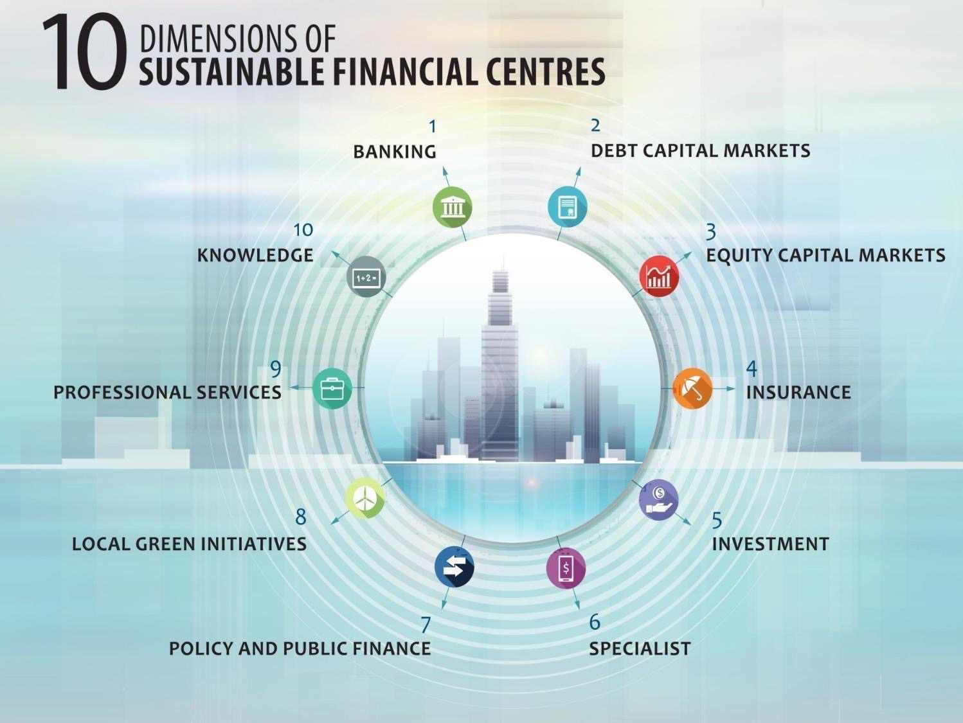

Slide 7









2015 – 2018: GROWING MOMENTUM
Agenda 2030 (SDGs):
Financing essential across infrastructure, innovation and inclusion
2015
COP 21 Paris Climate Agreement:
Making finance flows consistent with low GHG emissions and climate-resilient development
2015
FSB: Launch of Task Force on Climate-Related Financial Disclosures (TCFD)
2016
G20 China 2016
Green Finance Study Group:
G20 Heads of State pledge to scale up action; GFSG/SFSG continued in 2017 and 2018
2017
FC4S: Launch of FC4S Network with 11 founding centres
2017
European Union: Sustainable Finance strategy, High-Level strategic process (HLEG), leading to Technical Expert Group in 2018
2018
G7 Italy 2017:
Sustainable Finance – focus on Financial Centres & SMEs

Slide 8
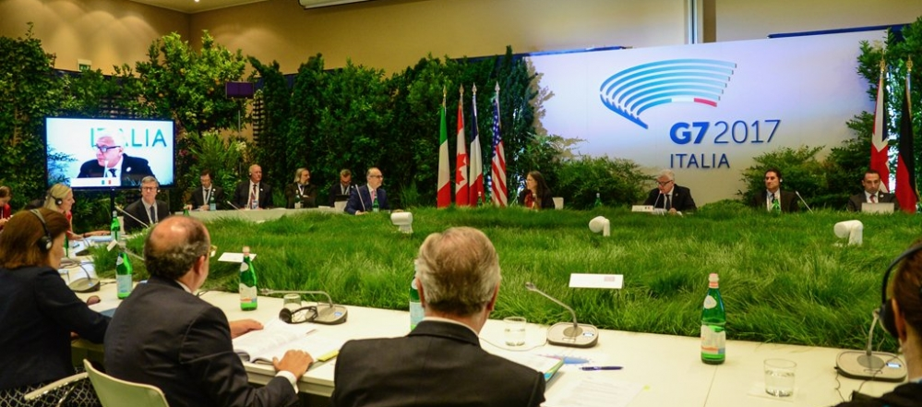
G7: ENDORSING FINANCIAL CENTER ACTION
“Sustainable finance is fundamental to achieve sustainability and climate goals… We recognise the commitments made by financial centres and the potential for these to be furthered through international cooperation...”
G7 Bologna Communique, 12 June 2017

Slide 9
ABOUT THE NETWORK
2019 FC4S Priorities

Slide 10
FC4S NETWORK – OVERVIEW
Organisation: a partnership between leading financial centres and the United Nations Environment Programme, with its Secretariat headquartered in Geneva
Objective: to “enable financial centres to exchange experience, drive convergence, and take action on shared priorities to accelerate the expansion of green and sustainable finance”
Members: currently 22 member financial centres , with a diversity of dedicated financial promotional bodies, public-private partnerships, private-sector task forces, government agencies
Coverage: Concentration of members in Europe and Asia, a strategic focus on Africa and the Americas
Funding: supported by governments seeking to promote sustainable finance, foundations and private sector

Slide 11








































FC4S MEMBERSHIP
Abu Dhabi
Liechtenstein
Astana
Milan
Barcelona
Nairobi International Financial Centre
Nairobi
Casablanca
New York
Dublin
Paris
Frankfurt
Seoul Metropolitan Government
Seoul
Geneva
Shanghai
Guernsey
Shenzhen Green Finance Committee
Shenzhen
Hong Kong
Stockholm
London
Toronto
Luxembourg
Zurich

Slide 12
2019 NETWORK STRATEGY
Key goals: Rapid growth in flows of sustainable finance across the world’s financial hubs, new strategic partnerships, better connectivity with the real economy
Secretariat Functions
Operations & Coordination
Strategic Advisory
Communications
Fundraising
Outputs and Deliverables (Work Programme)
Assessment & Strategies
FC Member Survey
Public Report
Profiling best practice
Stock-taking and guidance
Knowledge and training
Policy Dialogue
Public Authorities
Municipal Governments
Facilitating Collaborations
Regional Action
FC4S Europe
FC4S Asia
Other
Real Economy Lab
2019 AGM
Focus on Africa
New Centres, growing network to 30
Website, Media
Public and private donors
Technical assistance, bilateral partnerships
Developing regional hub
Americas (TBC)
Continued action, EC engagement
FC4S Africa

Slide 13
FC4S ADVISORY FRAMEWORK
Advisory Model: develop a shared vision for sustainable finance, identify points of competitiveness, forge cross-sectoral linkages, fill market gaps, and build connectivity

Slide 14
‘SHIFTING GEARS’
FC4S 2019 State of Play report

Slide 15
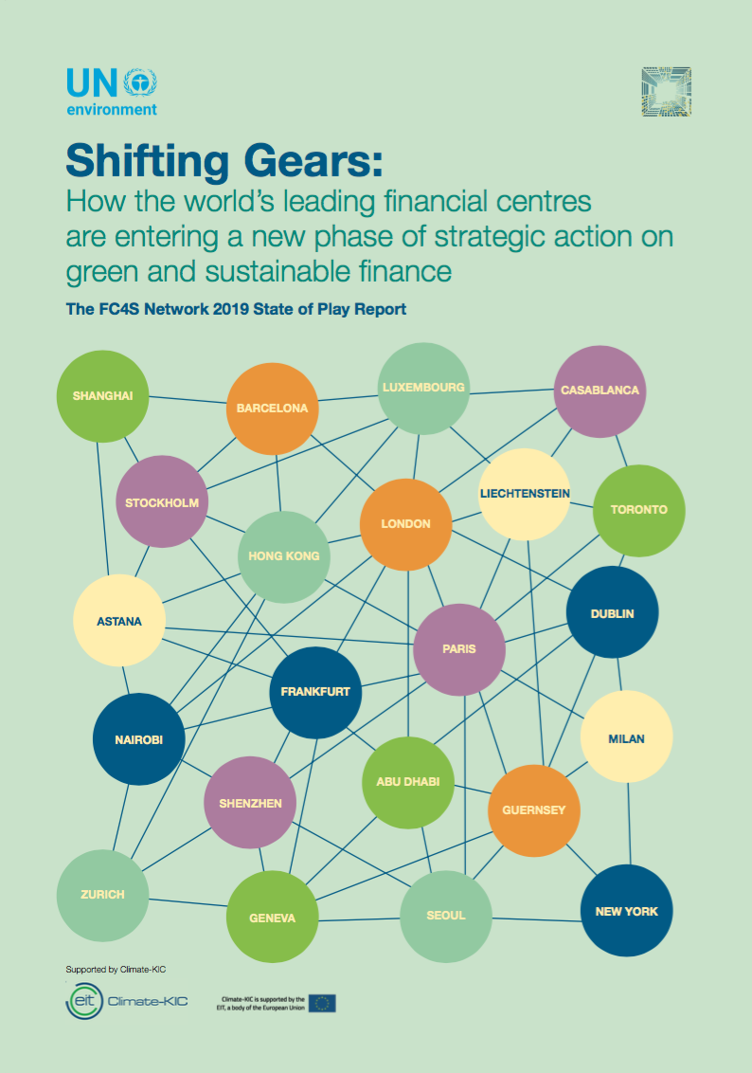

The FC4S Network 2019 State of Play Report
Key findings
Marga de Rosselló Carril
April 2019

Slide 16


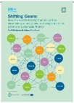

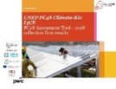
Key milestones of the FC4S Assessment Programme
-1 FC4S Network 2019 State of Play Report
Launch of the pilot of the FC4S Assessment Programme
17 Financial centres represented
2018, September
2nd Report,
Shifting Gears:
How the world's leading financial centres are entering a new phase of strategic action on green and sustainable finance
2019, March
First global meeting in Casablanca
11 Financial Centres represented
2017, September
2017, December
1st Report,
Benchmarking the greenness of financial centres
2017
G7, Italian Presidency,
birth of the project
2018, October
Shanghai meeting: presentation of the results of the pilot programme

Slide 17






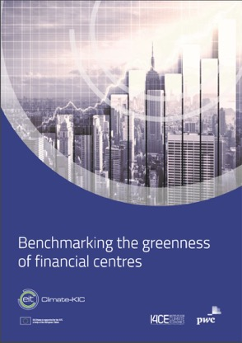
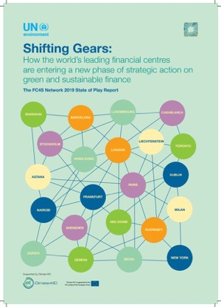
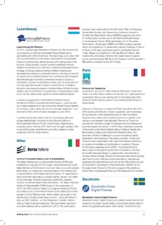
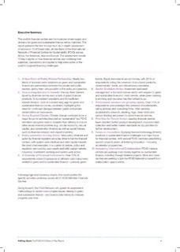
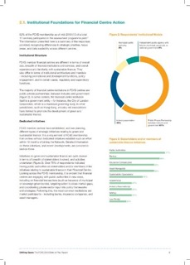
Information Sources and Data Inputs
-1 FC4S Network 2019 State of Play Report
1st Report
December 2017,
Comparative benchmark,
Third party data,
1 respondent from FC4S members
2nd Report
March 2019,
No third party data
Best practices and state of play
13 respondents from FC4S members
FC4S Assessment Programme:
Third party solicited:
Climate-Kic is supported by the EIT, a body of the European Union
Content:
FC4S member profiles
Executive Summary
Quantitative analyses

Slide 18
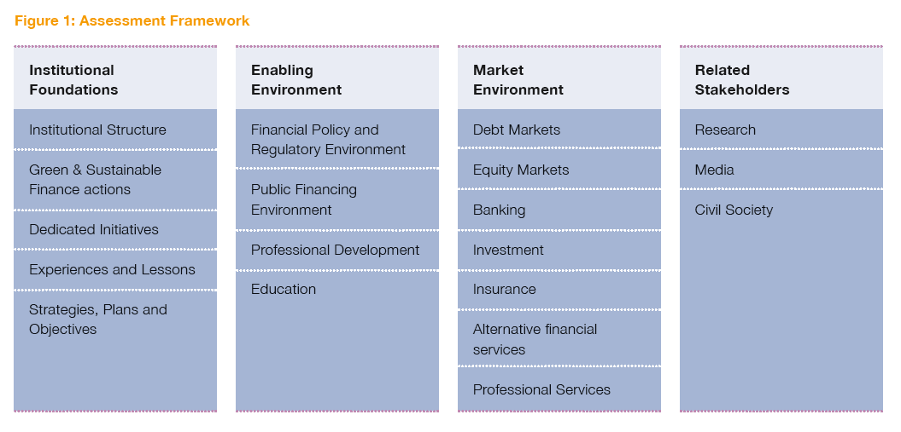
The FC4S Assessment Programme is built on a four-pillar framework developed by I4CE, PwC, and the FC4S Secretariat
In 2018, data was collected as part of a pilot programme
-1 FC4S Network 2019 State of Play Report
Extract from the second report, Shifting Gears, March 2019

Slide 19
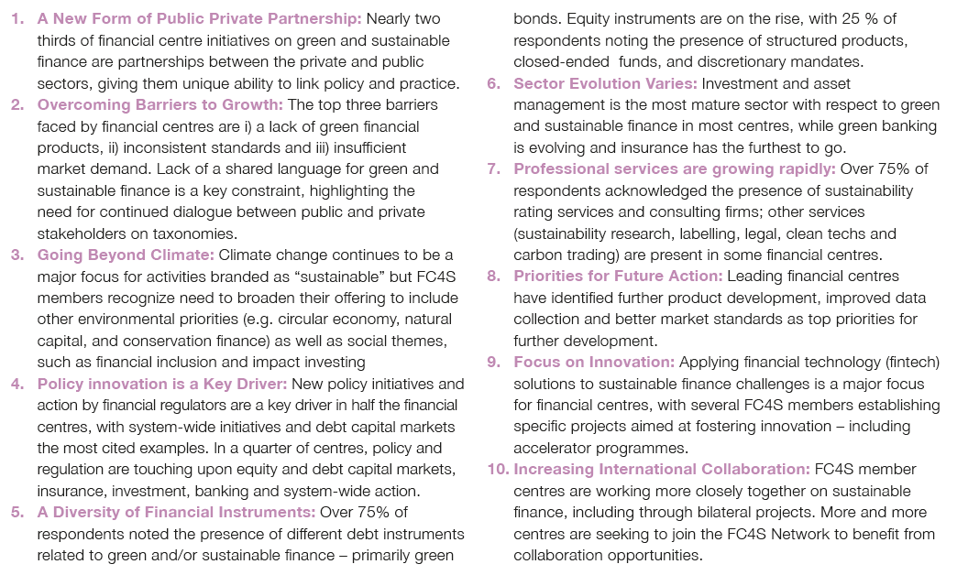
10 key insights on how financial centres are mobilizing their expertise, connectivity and capital to help solve some of the world’s toughest financing challenges:
A new form of public private partnership
Overcoming barriers to growth
Going beyond climate
Policy innovation is a key driver
A diversity of financial instruments
Sector evolution varies
Professional services are growing rapidly
Priorities for future action
Focus on innovation
Increasing International Collaboration

Slide 20
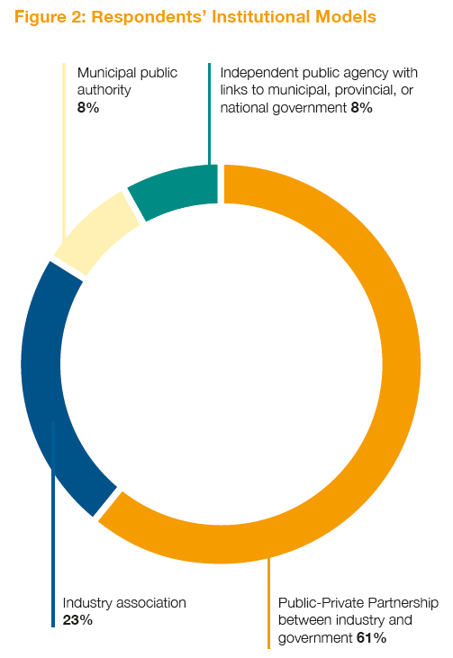
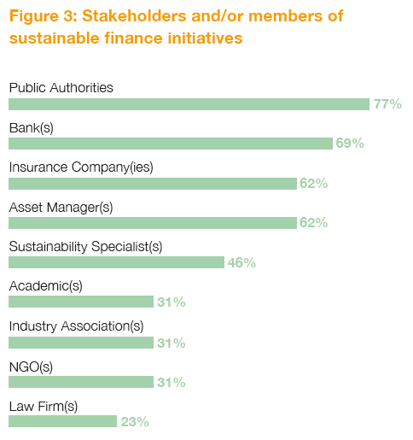
1. Institutional Foundations
Initiatives on green and sustainable finance are quite diverse in terms of breadth of stakeholders involved

Slide 21
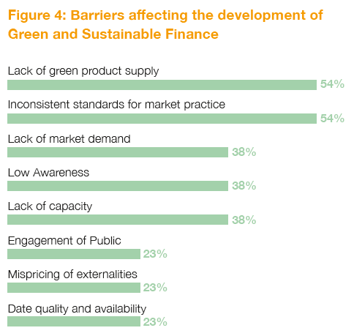
Challenges and key Barriers
Financial centres report common barriers to scaling up the expansion of green and sustainable finance in their markets

Slide 22
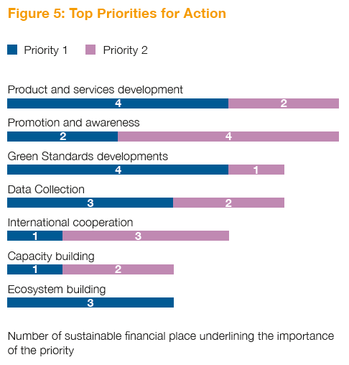
Strategic Priorities
Green products tend to be perceived in short supply from investors and in short demand from issuers, their development remains a top priority for several respondents
-1 FC4S Network 2019 State of Play Report

Slide 23
Strategic Priorities
Priorities can be seen as a function of a financial centre maturity level toward green and/or sustainable finance
-1 FC4S Network 2019 State of Play Report
Respondents’ maturity level
Mentioned by 3 respondents
Mentioned by 2 respondents
Sustainable finance education
Mentioned by 1 respondent
Growing maturity on sustainable finance
Promotion and awareness
Infrastructure building
Products and services development
Data collection
Key sustainable finance areas under development
Green standards development
International cooperation
Promotion and awareness
Starting up on sustainable finance
Capacity building
Priority #3
Priority #2
Priority #1

Slide 24
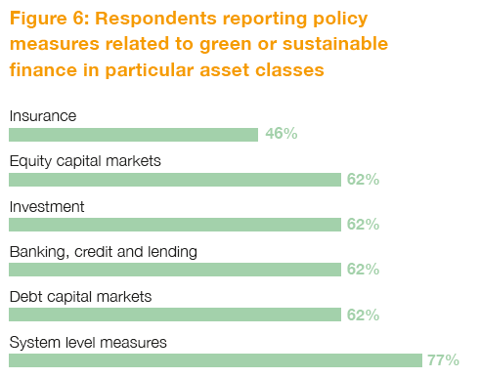
2. Enabling Environment
The majority of policy and regulatory measures in place are aimed at improving information flows, primarily through strengthening reporting by corporates and financial institutions
-1 FC4S Network 2019 State of Play Report

Slide 25
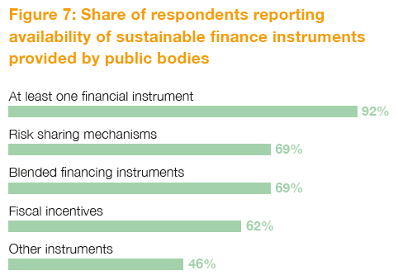
Enabling Environment
Nearly all respondents identified the presence of at least one financial instrument or incentive implemented by public authorities
-1 FC4S Network 2019 State of Play Report

Slide 26
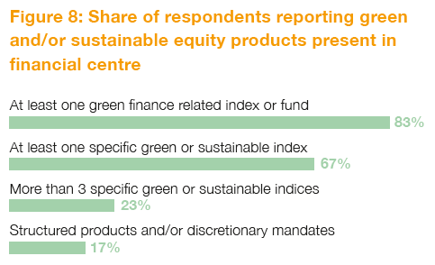
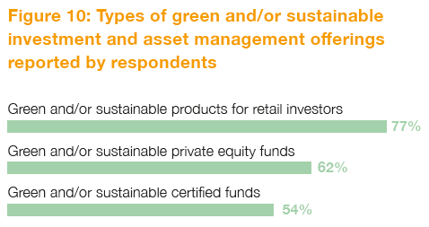
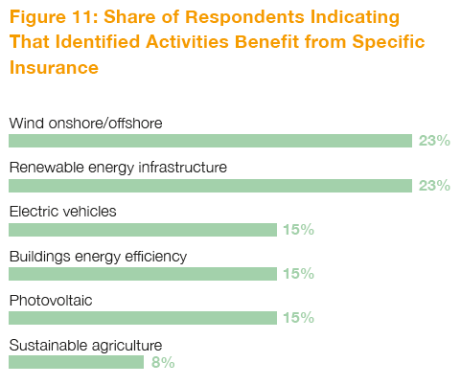
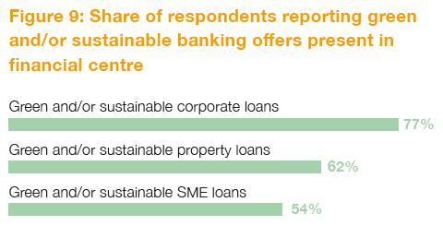
3. Market environment
Wide range of instruments present in FC4S member centres
-1 FC4S Network 2019 State of Play Report

Slide 27
4. Related Stakeholders
FC4S Centres host many groups of stakeholders active on green and/or sustainable finance topics
-1 FC4S Network 2019 State of Play Report
Figure 12: Share of respondents indicating presence of stakeholders on green and/or sustainable finance topics
Research institutes and think tanks collaboration
Media providing specialized information
Civil society and NGOs active

Slide 28
FC4S ASSESSMENT PROGRAMME – NEXT STEPS
Partial analysis: many important issues that 2018 pilot programme did not tackle – including capital flows and volumes, compatibility across markets, and dynamics of institutional collaboration
Revision process: FC4S Secretariat will revise assessment methodology to target more complex, diversified questions – and build up data history
Measuring Progress: generate a set of shared criteria through which to measure progress across different ‘levels of alignment’ on sustainable finance priorities
Mandatory implementation: As of 2019, all FC4S members are required to respond to the Assessment Programme survey

Slide 29
FC4S EUROPE
Policy engagement & strategy development

Slide 30
REGIONAL ACTION - EUROPE
Europe’s financial centres are leaders on sustainable finance, and the policy momentum is growing fast (recently launched EU Action Plan).
A European Hub (EU-FC4S) was established with the support of Climate-KIC to broaden and deepen action.
  Engaging Europe’s 30+ financial centres to finance sustainable development at municipal, national, and international levels
  Building connectivity across Europe’s financial centres, enabling peer learning, shared activities and innovation.
At the global level, the EU Hub will strengthen engagement with leading centres, and export European innovation to the world.
Regional platforms in development for Africa, the Americas, and Asia.

Slide 31
WORKING WITH EUROPEAN COMMISSION
FC4S Network has been engaging with the European Commission’s DG-FISMA, to support the engagement of financial centres in the implementation of the Action Plan on Sustainable Finance
At the EC’s High-Level Conference on Sustainable Finance in March 2019, the FC4S Network convened an expert meeting on how fintech solutions could be applied to accelerate sustainable finance in Europe – and address complex implementation issues
FC4S Network was named a partner for the European Commission’s proposed government partnership on sustainable finance
Valdis Dombrovskis, Vice President of the European Commission: “I welcome the report of the UN FC4S Network, which for the first time assesses the contribution of financial centres to sustainable development. We need to build global cooperation to coordinate an international approach to sustainable finance that avoids fragmentation and greenwashing.”

Slide 32
STRATEGIC FOCUS ON AFRICA
In 2019, the FC4S Network will have a special strategic focus on raising sustainable finance within, and to, African countries – where sustainable finance needs are the highest, and yet actual flows of finance lowest
Coordinated effort to help mainstream sustainable finance as a foundational element of financial centre strategies:
  Capacity building, technical assistance and advisory services
  Engaging new centres as FC4S members
  Delivering bilateral partnerships with leading global centres
  Special meeting on Sustainable Finance for Africa alongside FC4S Assembly meeting (October 2019)

Slide 33
LONG-TERM VISION
By 2020, the Network will have:
Mobilised the world’s key financial centres to accelerate their action on climate change and sustainable development.
Enabled both sophisticated and emerging financial centres to deepen their practical engagement on sustainable finance priorities.
Provided a valued and trusted platform for members, stakeholders and policymakers.
Made a material contribution to scaling up flows of sustainable finance for a world economy in transition.

